Slide 1
Tactics for Building Background Services in .NET
Kevin Griffin
twitter.com/1kevgriff
@1kevgriff@bbiz.io

Slide 2

Notes:
Story: the on-demand email

Slide 3
👋 I’m Kevin

Slide 4
Courses

Slide 5

Agenda
Background Tasks
Tactics
Hosted Services
Windows Services
ASP.NET Core Hosted Services
Quartz
HangFire
Azure Functions

Slide 6

Background Tasks
On Demand
Tasks that need to occur sooner than later
Examples:
Emails
Payment Processing
Webhooks
Entity Processing

Slide 7

Background Tasks
Recurring Task
Tasks that need to happen on a schedule
Hourly, Daily, Weekly, etc
Examples:
Reports
Resource Cleanup

Slide 8
Considerations
Where are you hosting?
Local
Windows Service
Inside existing client app
Web
ASP.NET Core app
Microsoft Azure
AWS

Slide 9
Considerations
Resiliency
What happens if a task fails?
What happens if a service crashes?

Slide 10
.NET Hosted Services

Slide 11
.NET Hosted Services

Slide 12
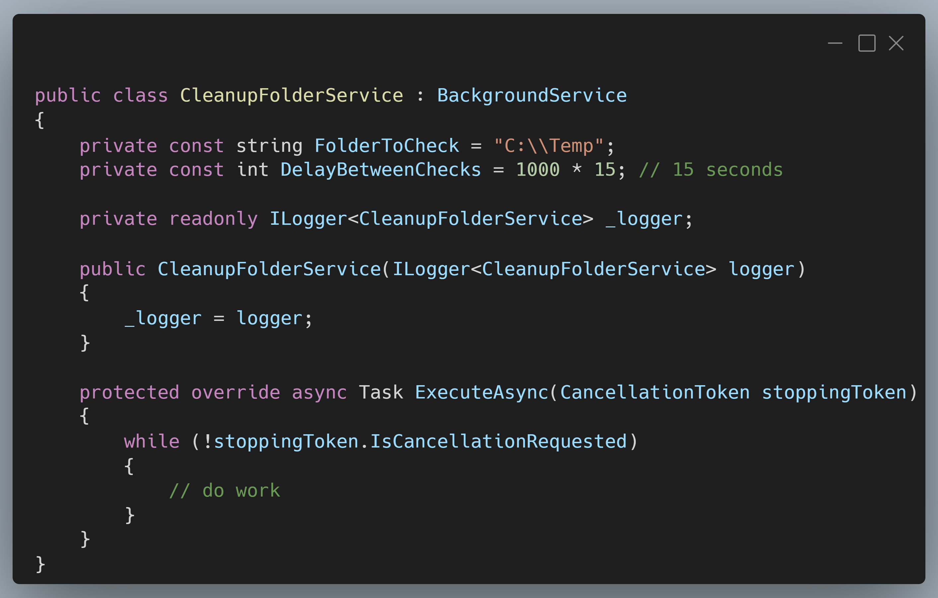
.NET Hosted Services
Notes:
Introduce concept of hosted services
Examples in .NET Console and ASP.NET Core
Screenshot: https://carbon.now.sh/?bg=rgba%28171%2C+184%2C+195%2C+1%29&t=vscode&wt=boxy&l=text%2Fx-csharp&width=680&ds=true&dsyoff=20px&dsblur=68px&wc=true&wa=true&pv=11px&ph=10px&ln=false&fl=1&fm=Hack&fs=14px&lh=133%25&si=false&es=4x&wm=false&code=public%2520class%2520CleanupFolderService%2520%253A%2520BackgroundService%250A%257B%250A%2520%2520%2520%2520private%2520const%2520string%2520FolderToCheck%2520%253D%2520%2522C%253A%255C%255CTemp%2522%253B%250A%2520%2520%2520%2520private%2520const%2520int%2520DelayBetweenChecks%2520%253D%25201000%2520*%252015%253B%2520%252F%252F%252015%2520seconds%250A%250A%2520%2520%2520%2520private%2520readonly%2520ILogger%253CCleanupFolderService%253E%2520_logger%253B%250A%250A%2520%2520%2520%2520public%2520CleanupFolderService%28ILogger%253CCleanupFolderService%253E%2520logger%29%250A%2520%2520%2520%2520%257B%250A%2520%2520%2520%2520%2520%2520%2520%2520_logger%2520%253D%2520logger%253B%250A%2520%2520%2520%2520%257D%250A%250A%2520%2520%2520%2520protected%2520override%2520async%2520Task%2520ExecuteAsync%28CancellationToken%2520stoppingToken%29%250A%2520%2520%2520%2520%257B%250A%2520%2520%2520%2520%2520%2520%2520%2520while%2520%28%21stoppingToken.IsCancellationRequested%29%250A%2520%2520%2520%2520%2520%2520%2520%2520%257B%250A%2520%2520%2520%2520%2520%2520%2520%2520%2509%252F%252F%2520do%2520work%250A%2520%2520%2520%2520%2520%2520%2520%2520%257D%250A%2520%2520%2520%2520%257D%250A%257D

Slide 13
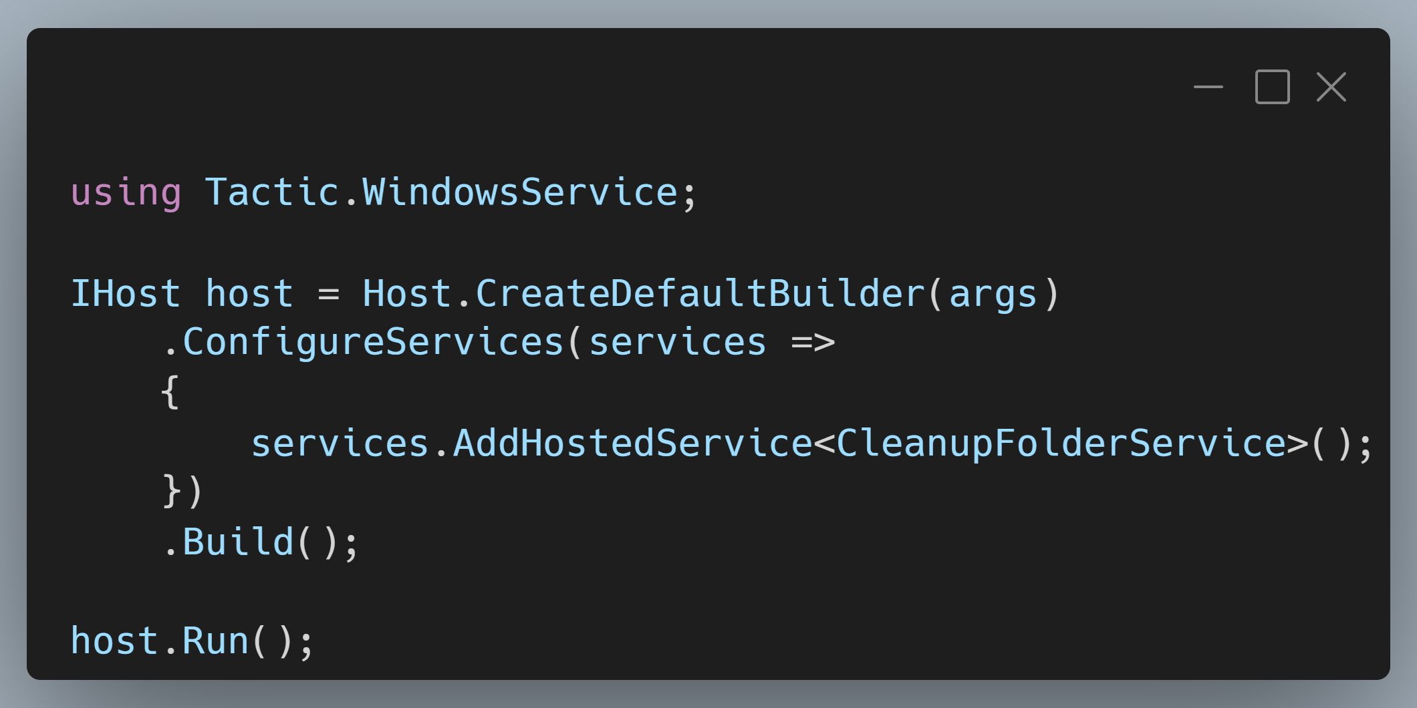
.NET Hosted Services
Notes:
Screenshot: https://carbon.now.sh/?bg=rgba%28171%2C+184%2C+195%2C+1%29&t=vscode&wt=boxy&l=text%2Fx-csharp&width=680&ds=true&dsyoff=20px&dsblur=68px&wc=true&wa=true&pv=11px&ph=10px&ln=false&fl=1&fm=Hack&fs=14px&lh=133%25&si=false&es=4x&wm=false&code=using%2520Tactic.WindowsService%253B%250A%250AIHost%2520host%2520%253D%2520Host.CreateDefaultBuilder%28args%29%250A%2520%2520%2520%2520.ConfigureServices%28services%2520%253D%253E%250A%2520%2520%2520%2520%257B%250A%2520%2520%2520%2520%2520%2520%2520%2520services.AddHostedService%253CCleanupFolderService%253E%28%29%253B%250A%2520%2520%2520%2520%257D%29%250A%2520%2520%2520%2520.Build%28%29%253B%250A%250Ahost.Run%28%29%253B

Slide 14
Windows Service

Slide 15
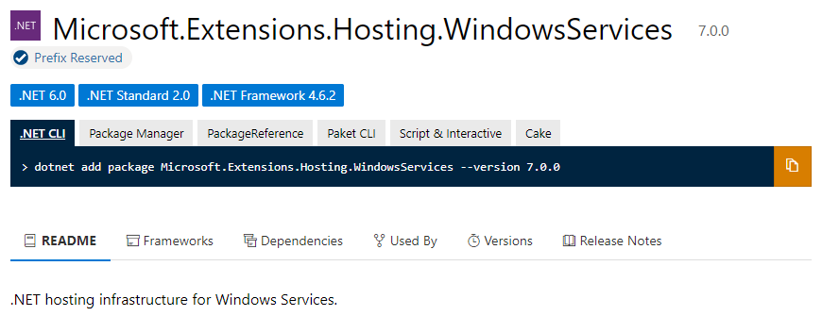
Windows Services

Slide 16
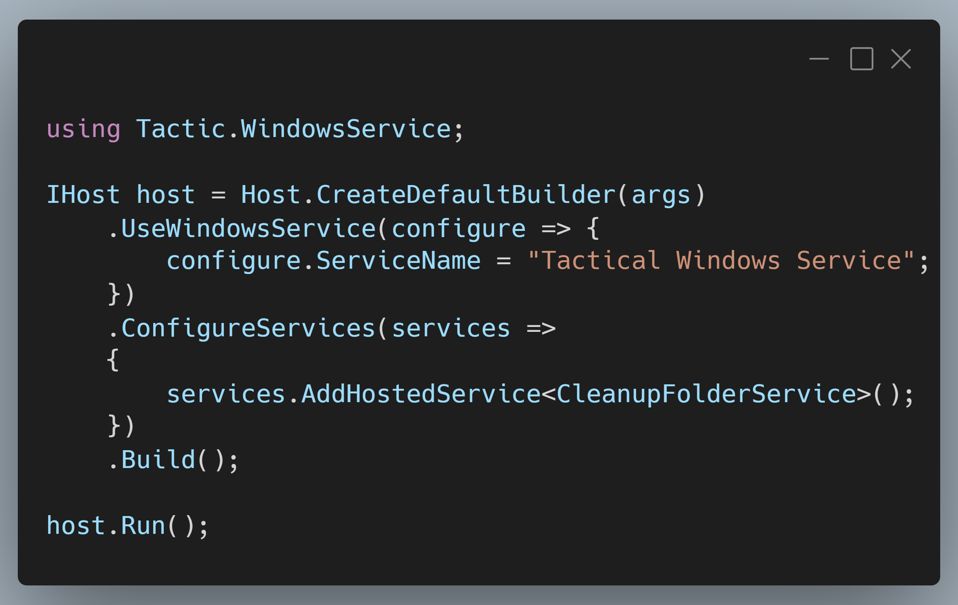
Windows Services
Notes:
Screenshot: https://carbon.now.sh/?bg=rgba%28171%2C+184%2C+195%2C+1%29&t=vscode&wt=boxy&l=text%2Fx-csharp&width=680&ds=true&dsyoff=20px&dsblur=68px&wc=true&wa=true&pv=11px&ph=10px&ln=false&fl=1&fm=Hack&fs=14px&lh=133%25&si=false&es=4x&wm=false&code=using%2520Tactic.WindowsService%253B%250A%250AIHost%2520host%2520%253D%2520Host.CreateDefaultBuilder%28args%29%250A%2520%2520%2520%2520.UseWindowsService%28configure%2520%253D%253E%2520%257B%250A%2520%2520%2520%2520%2520%2520%2520%2520configure.ServiceName%2520%253D%2520%2522Tactical%2520Windows%2520Service%2522%253B%250A%2520%2520%2520%2520%257D%29%250A%2520%2520%2520%2520.ConfigureServices%28services%2520%253D%253E%250A%2520%2520%2520%2520%257B%250A%2520%2520%2520%2520%2520%2520%2520%2520services.AddHostedService%253CCleanupFolderService%253E%28%29%253B%250A%2520%2520%2520%2520%257D%29%250A%2520%2520%2520%2520.Build%28%29%253B%250A%250Ahost.Run%28%29%253B%250A

Slide 17
Demo
Windows Services

Slide 18
Window Services
Pros
Easy to build!
Windows will automatically manage lifecycle for you
Cons
Limited to single machine/server
Not straight forward to do “on-demand” work
You’re responsible for resiliency of individual tasks

Slide 19
ASP.NET Core Hosted Services

Slide 20
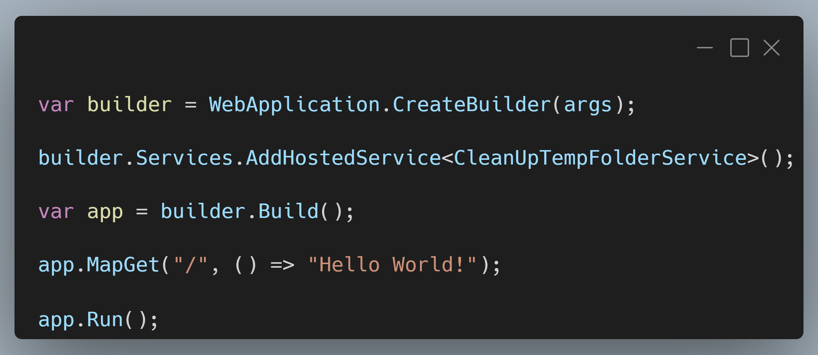
ASP.NET Core Hosted Services
Notes:
SCREENSHOT: https://carbon.now.sh/?bg=rgba%28171%2C+184%2C+195%2C+1%29&t=vscode&wt=boxy&l=text%2Fx-csharp&width=680&ds=true&dsyoff=20px&dsblur=68px&wc=true&wa=true&pv=11px&ph=10px&ln=false&fl=1&fm=Hack&fs=14px&lh=133%25&si=false&es=4x&wm=false&code=var%2520builder%2520%253D%2520WebApplication.CreateBuilder%28args%29%253B%250A%250Abuilder.Services.AddHostedService%253CCleanUpTempFolderService%253E%28%29%253B%250A%250Avar%2520app%2520%253D%2520builder.Build%28%29%253B%250A%250Aapp.MapGet%28%2522%252F%2522%252C%2520%28%29%2520%253D%253E%2520%2522Hello%2520World%21%2522%29%253B%250A%250Aapp.Run%28%29%253B

Slide 21
Demo
ASP.NET Core Hosted Services

Slide 22
ASP.NET Core Hosted Services
Pros
Easy to build!
Runs inside of your existing ASP.NET Core Host
Automatically starts on app startup
Cons
You’re responsible for scheduling (with Quartz or custom process)
You’re responsible for resiliency of individual tasks

Slide 23
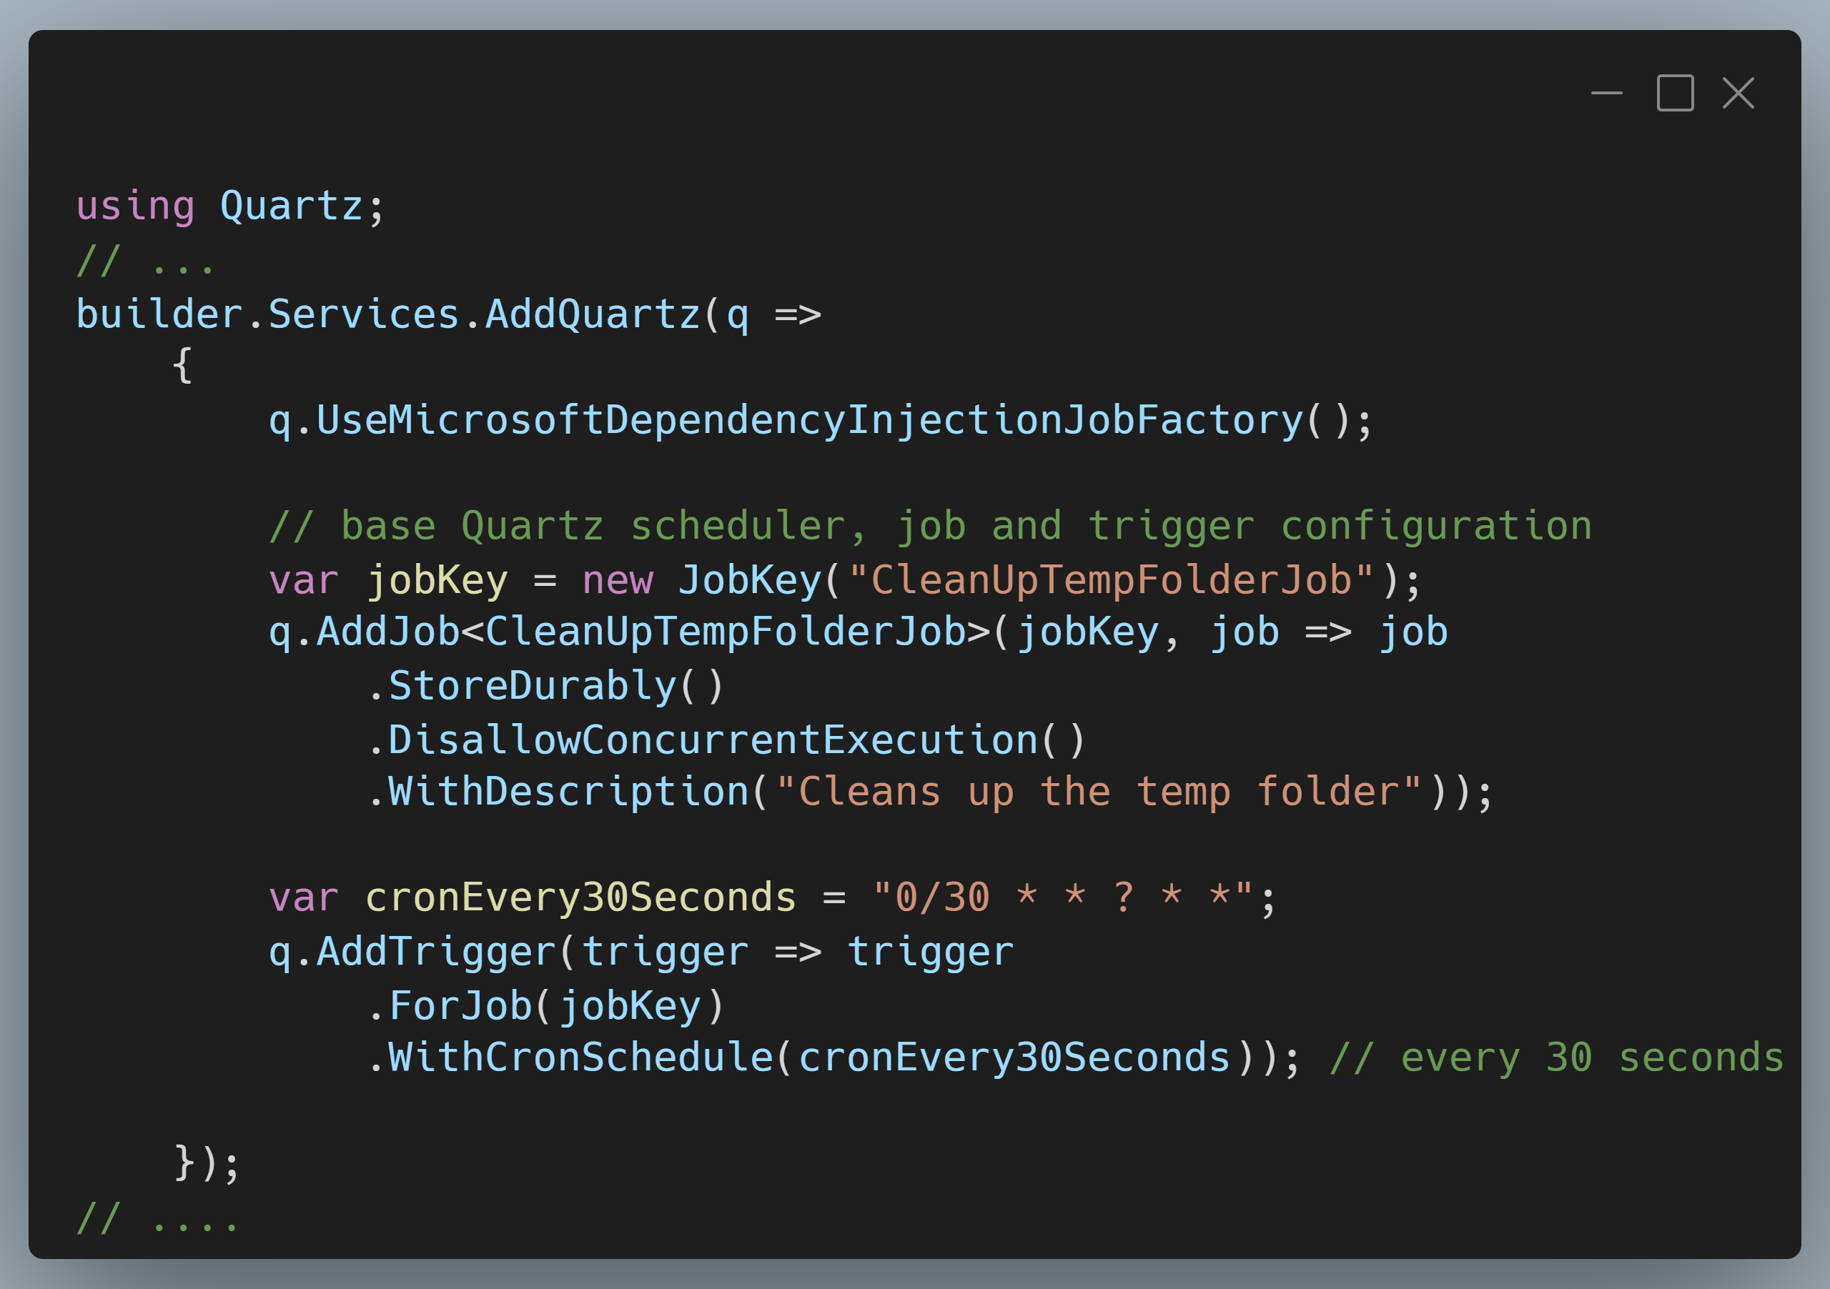
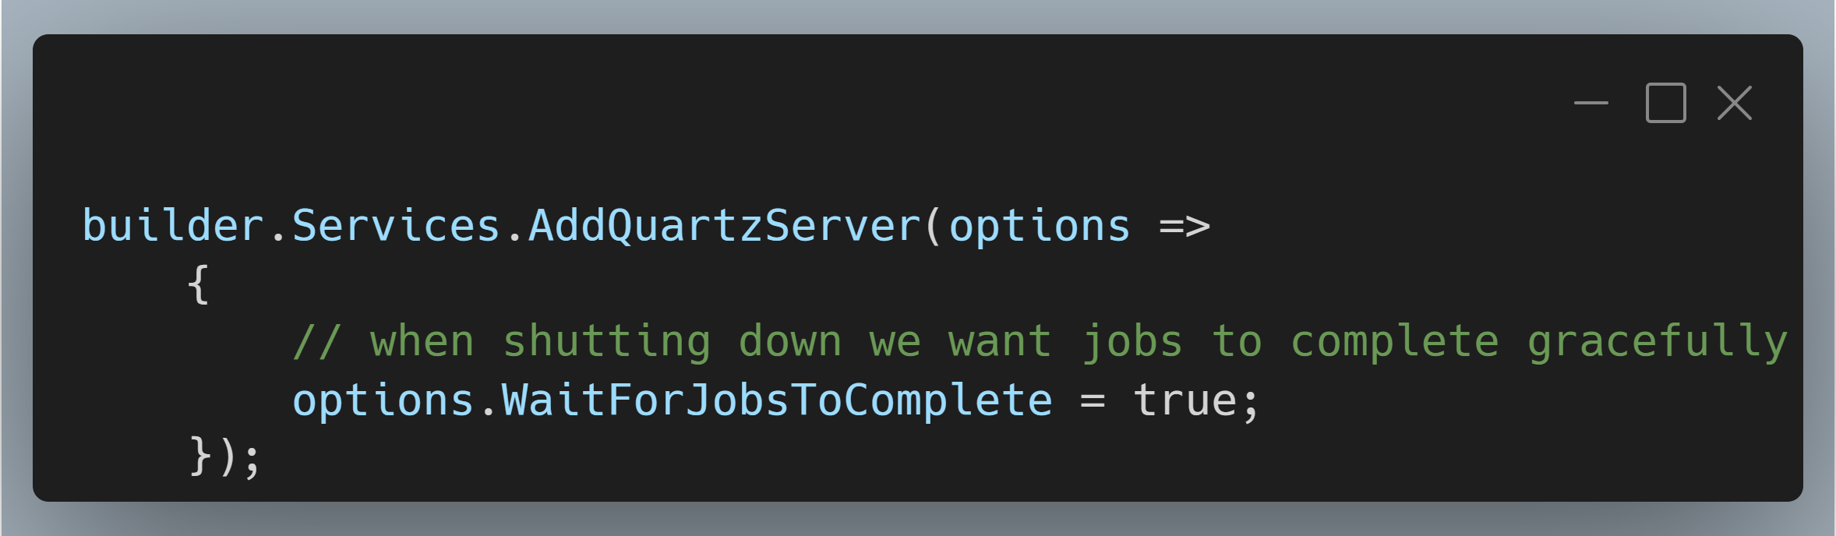
Scheduling with Quartz
Notes:
SCREENSHOT 1: https://carbon.now.sh/?bg=rgba%28171%2C+184%2C+195%2C+1%29&t=vscode&wt=boxy&l=text%2Fx-csharp&width=680&ds=true&dsyoff=20px&dsblur=68px&wc=true&wa=true&pv=11px&ph=10px&ln=false&fl=1&fm=Hack&fs=14px&lh=133%25&si=false&es=4x&wm=false&code=using%2520Quartz%253B%250A%252F%252F%2520...%250Abuilder.Services.AddQuartz%28q%2520%253D%253E%250A%2520%2520%2520%2520%257B%250A%2520%2520%2520%2520%2520%2520%2520%2520q.UseMicrosoftDependencyInjectionJobFactory%28%29%253B%250A%250A%2520%2520%2520%2520%2520%2520%2520%2520%252F%252F%2520base%2520Quartz%2520scheduler%252C%2520job%2520and%2520trigger%2520configuration%250A%2520%2520%2520%2520%2520%2520%2520%2520var%2520jobKey%2520%253D%2520new%2520JobKey%28%2522CleanUpTempFolderJob%2522%29%253B%250A%2520%2520%2520%2520%2520%2520%2520%2520q.AddJob%253CCleanUpTempFolderJob%253E%28jobKey%252C%2520job%2520%253D%253E%2520job%250A%2520%2520%2520%2520%2520%2520%2520%2520%2520%2520%2520%2520.StoreDurably%28%29%250A%2520%2520%2520%2520%2520%2520%2520%2520%2520%2520%2520%2520.DisallowConcurrentExecution%28%29%250A%2520%2520%2520%2520%2520%2520%2520%2520%2520%2520%2520%2520.WithDescription%28%2522Cleans%2520up%2520the%2520temp%2520folder%2522%29%29%253B%250A%250A%2520%2520%2520%2520%2520%2520%2520%2520var%2520cronEvery30Seconds%2520%253D%2520%25220%252F30%2520*%2520*%2520%253F%2520*%2520*%2522%253B%250A%2520%2520%2520%2520%2520%2520%2520%2520q.AddTrigger%28trigger%2520%253D%253E%2520trigger%250A%2520%2520%2520%2520%2520%2520%2520%2520%2520%2520%2520%2520.ForJob%28jobKey%29%250A%2520%2520%2520%2520%2520%2520%2520%2520%2520%2520%2520%2520.WithCronSchedule%28cronEvery30Seconds%29%29%253B%2520%252F%252F%2520every%252030%2520seconds%250A%250A%2520%2520%2520%2520%257D%29%253B%250A%252F%252F%2520....
Screenshot 2: https://carbon.now.sh/?bg=rgba%28171%2C+184%2C+195%2C+1%29&t=vscode&wt=boxy&l=text%2Fx-csharp&width=680&ds=true&dsyoff=20px&dsblur=68px&wc=true&wa=true&pv=11px&ph=10px&ln=false&fl=1&fm=Hack&fs=14px&lh=133%25&si=false&es=4x&wm=false&code=builder.Services.AddQuartzServer%28options%2520%253D%253E%250A%2520%2520%2520%2520%257B%250A%2520%2520%2520%2520%2520%2520%2520%2520%252F%252F%2520when%2520shutting%2520down%2520we%2520want%2520jobs%2520to%2520complete%2520gracefully%250A%2520%2520%2520%2520%2520%2520%2520%2520options.WaitForJobsToComplete%2520%253D%2520true%253B%250A%2520%2520%2520%2520%257D%29%253B

Slide 24
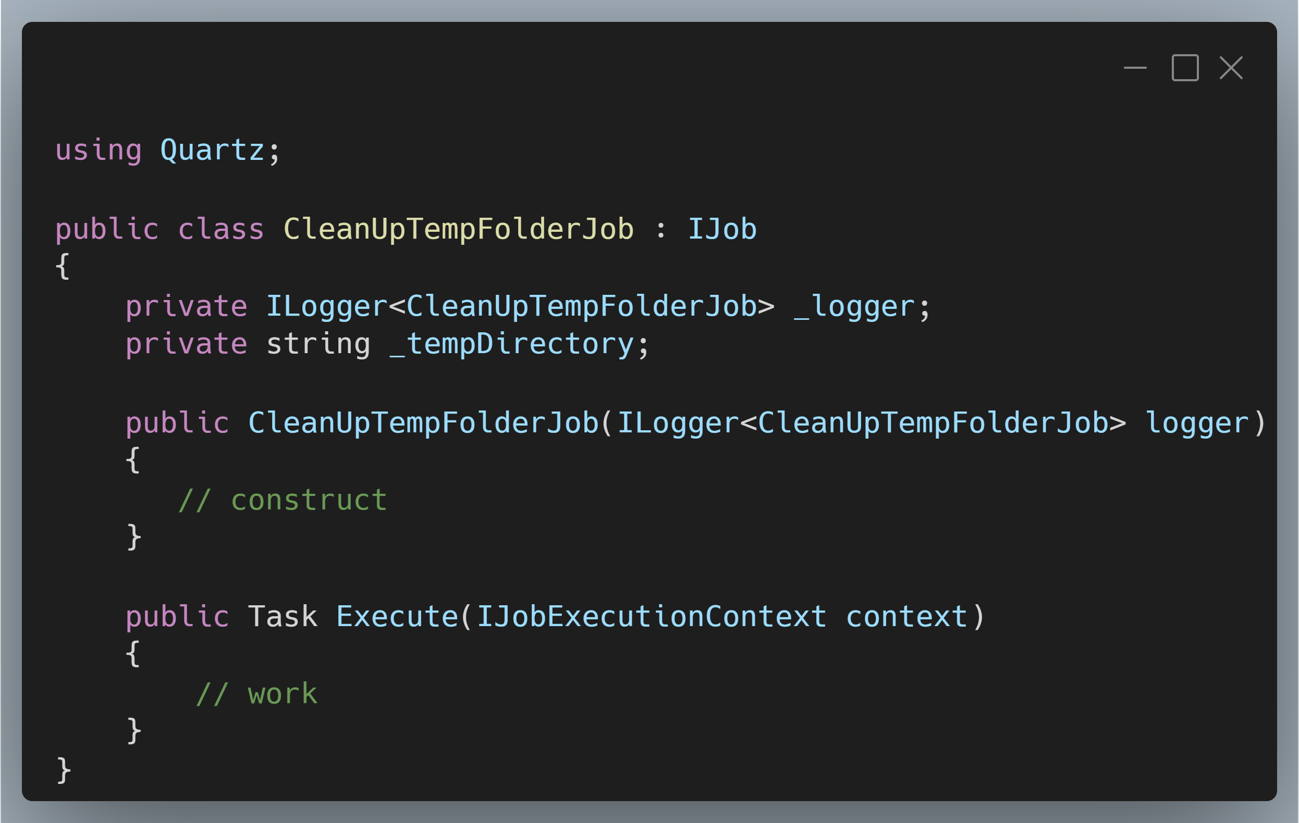
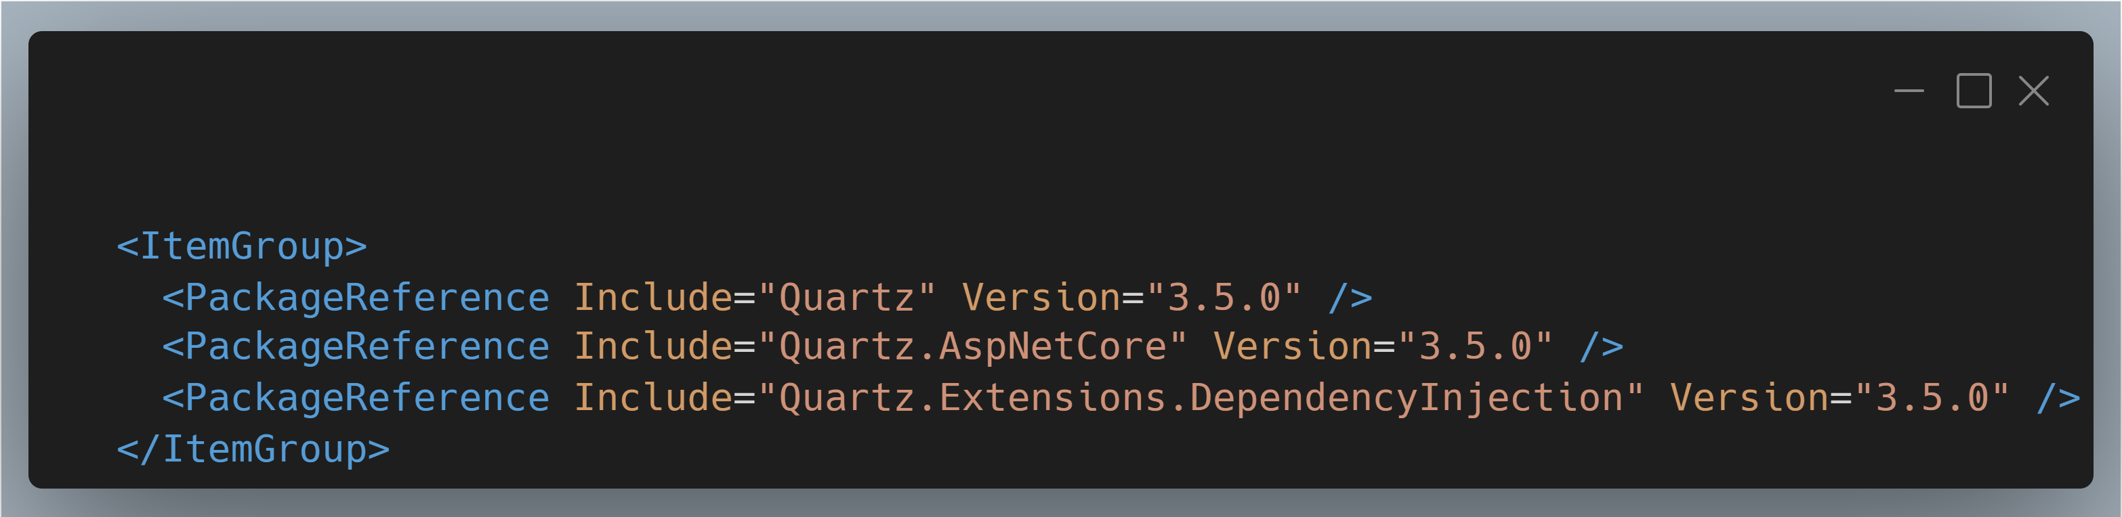
Scheduling with Quartz

Slide 25
Demo
Quartz

Slide 26
Quartz
Pros
Precise scheduling and timing!
One off jobs as you want to schedule them
Separate “job server” so your app isn’t doing dual duty
Cons
Locking into Quartz jobs
Additional configuration to tie into DI framework

Slide 27
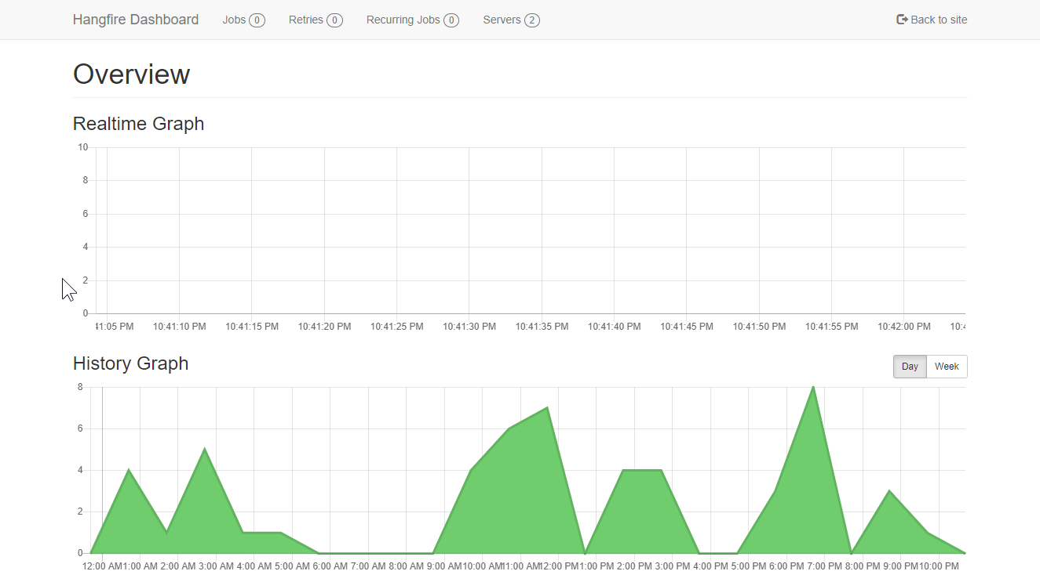
HangFire

Slide 28
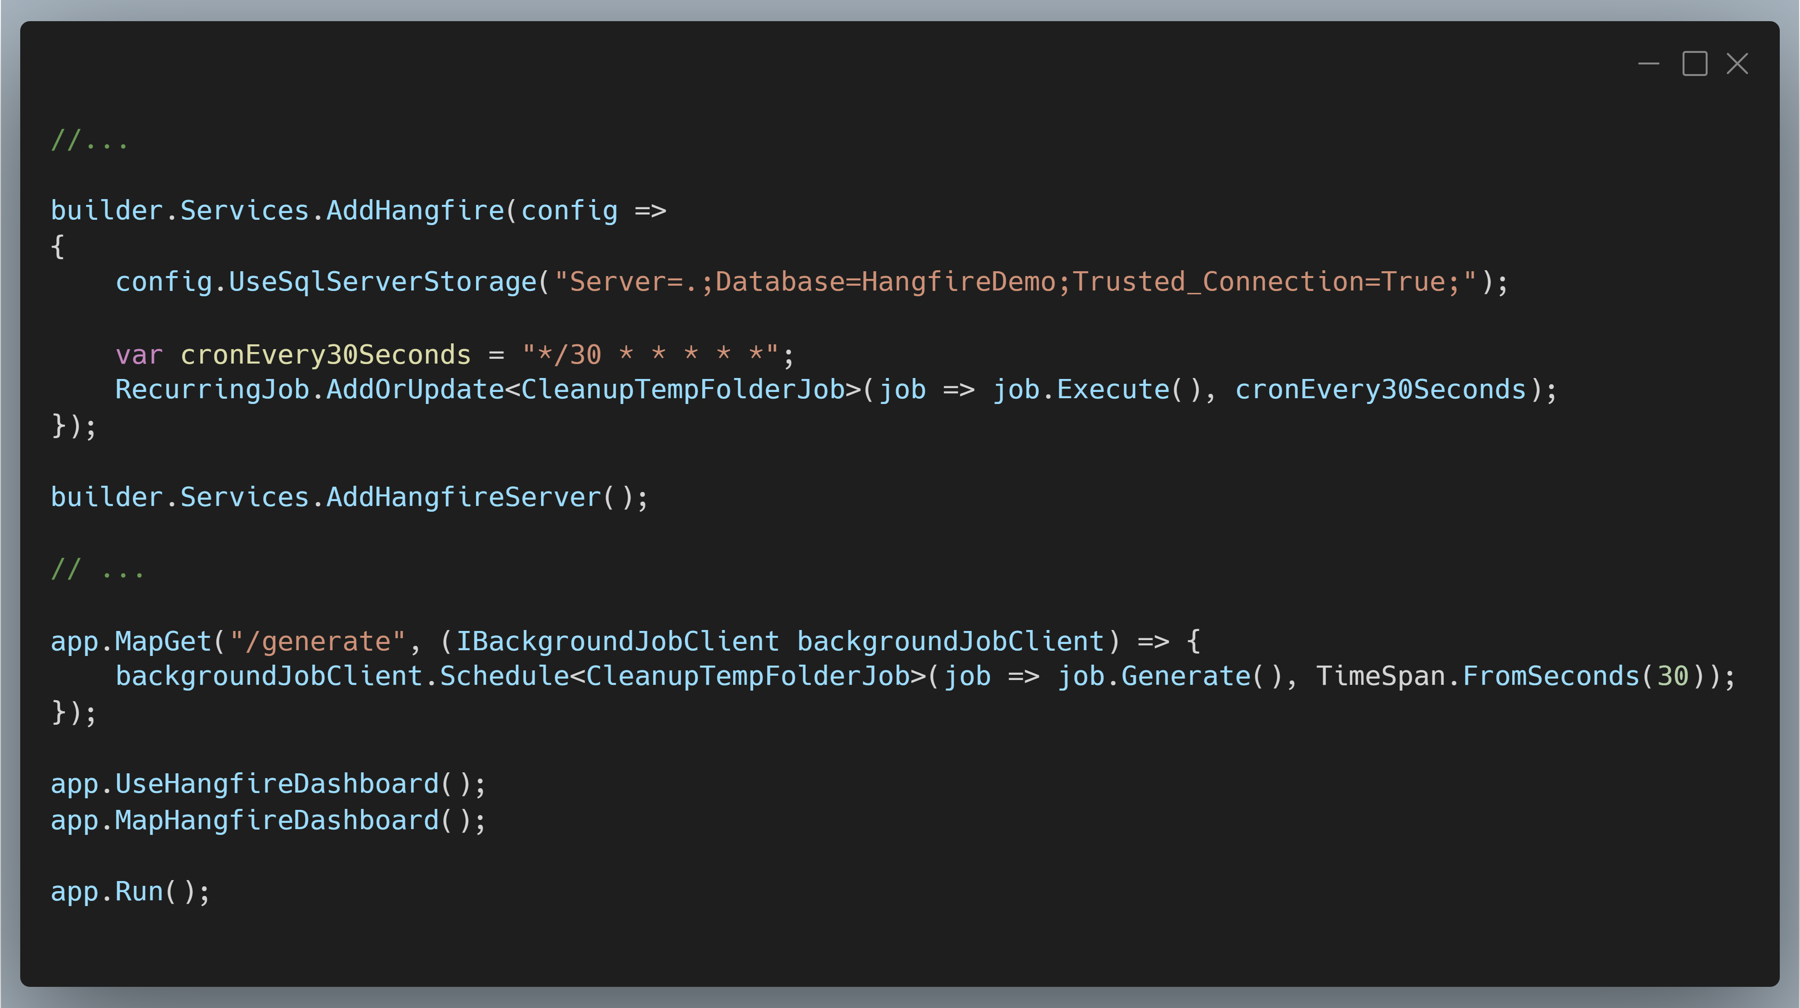
HangFire

Slide 29
Demo
HangFire

Slide 30
HangFire
Pros
Precise scheduling and timing!
One off jobs as you want to schedule them
Strongly typed jobs
UI is amazing
Cons
Best data stores are paywalled
Separate job server is a PAIN IN THE BUTT

Slide 31
Azure Functions
Notes:
QueueTrigger
HttpTrigger
Maybe discuss service bus topics too?

Slide 32
Demo
Azure Functions

Slide 33
Azure Functions
Pros
Precise scheduling and timing!
CLOUD SCALE
Tasks are independently resilient
Cons
Azure requirement

Slide 34
Azure Web Jobs
Notes:
QueueTrigger
HttpTrigger
Maybe discuss service bus topics too?

